Slide 1
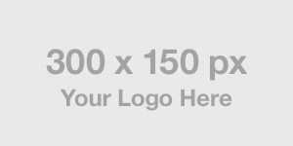
Marketing
Tool Kit
Month 2020

Slide 2
Welcome
Welcome
This document is designed for [Company Name]’s partner and sponsor ecosystem. When communicating together, in various partnership environments, we want to safeguard our brand and assist you in:
Featuring and referencing the [Company Name] brand effectively and correctly
Providing access to the correct [Company Name] brand assets
All partner led creatives must be preapproved by the [Company Name] brand team.
Logo Usage
Logo
Partnership Lockup
Usage Guidelines
Color
Primary brand colors
Secondary colors
Messaging
Press releases
Typography
Assets
Download Brand Assets
2

Slide 3
1. Logo Usage
Logo Usage
Logo The logo should be white on darker backgrounds and black on lighter backgrounds.
Partnership Lockup Aligning partnership logo should follow space rule of 30% of [Company Name] logo.
30%
30%
3

Slide 4
1. Logo Usage
Logo Usage
Usage Guidelines You want to promote your content, and we want to help. You’re welcome to use the [Company Name] name and Logo long as you adhere to the Logo usage guidelines.
Do
Don’t
Get every use of any [Company Name] brand element approved by [Company Name]
Follow all guidelines for the [Company Name] brand
Avoid repetitive use of the [Company Name] logo in design materials
Ensure logos in use are up to date
Use the standard Logo to promote your content when linking or driving traffic to your content
Use logos or brand elements to drive to sites outside of [Company Name] unless approved by [Company Name]
Modify logos or other brand elements in any way, including but not limited to altering proportions, positions, stretching, condensing, changing color or typefaces, flipping or rotating, or adding effects
Place the full-color logo on red (due to lack of visibility)
Partially cover the logo
Place an image within the logo
4

Slide 5
2. Color
Color
Primary Brand Colors Our primary brand colors are used to provide accessibility, simplicity, and consistency throughout all brand communications.
Secondary Brand Colors Secondary brand colors should be
used sparingly throughout illustration,
photography, and product in order to
maintain meaning and potency.
Black
Black
Black
RGB: 0 0 0
CMYK: 70 35 40 100
HEX: 000000
PMS: Black 6 C
RGB: 0 0 0
CMYK: 70 35 40 100
HEX: 000000
PMS: Black 6 C
RGB: 0 0 0
CMYK: 70 35 40 100
HEX: 000000
PMS: Black 6 C
Black
Black
Black
Black
RGB: 0 0 000
HEX: 000000
CMYK: 70 35 40 100
PMS: Black 6 C
RGB: 0 0 000
HEX: 000000
CMYK: 70 35 40 100
PMS: Black 6 C
RGB: 0 0 000
HEX: 000000
CMYK: 70 35 40 100
PMS: Black 6 C
RGB: 0 0 000
HEX: 000000
CMYK: 70 35 40 100
PMS: Black 6 C
5

Slide 6
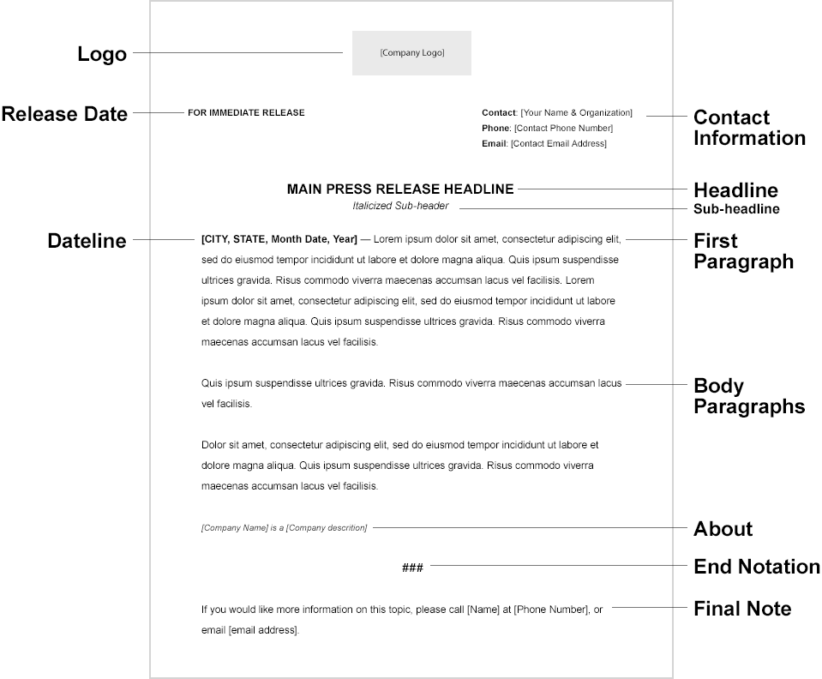
3. Messaging
Messaging
Press Releases Write press releases in the AP Style. An AP Style press release, or Associated Press-style press release, is a statement for the press that is correctly styled within AP guidelines. It is utilized by businesses that want to announce an event, release, or hire. It helps to increase a business’ exposure by generating possible media coverage and consumer awareness of their business.
When writing an AP Style press release, it is recommended that you follow the accepted press release format structure. Media outlets, journalists, and search engines will all expect to see this specific format so they can find important information quickly.
For any press release, please consult with your Securities Law Counsel for any public dissemination of information about your company.
6

Slide 7
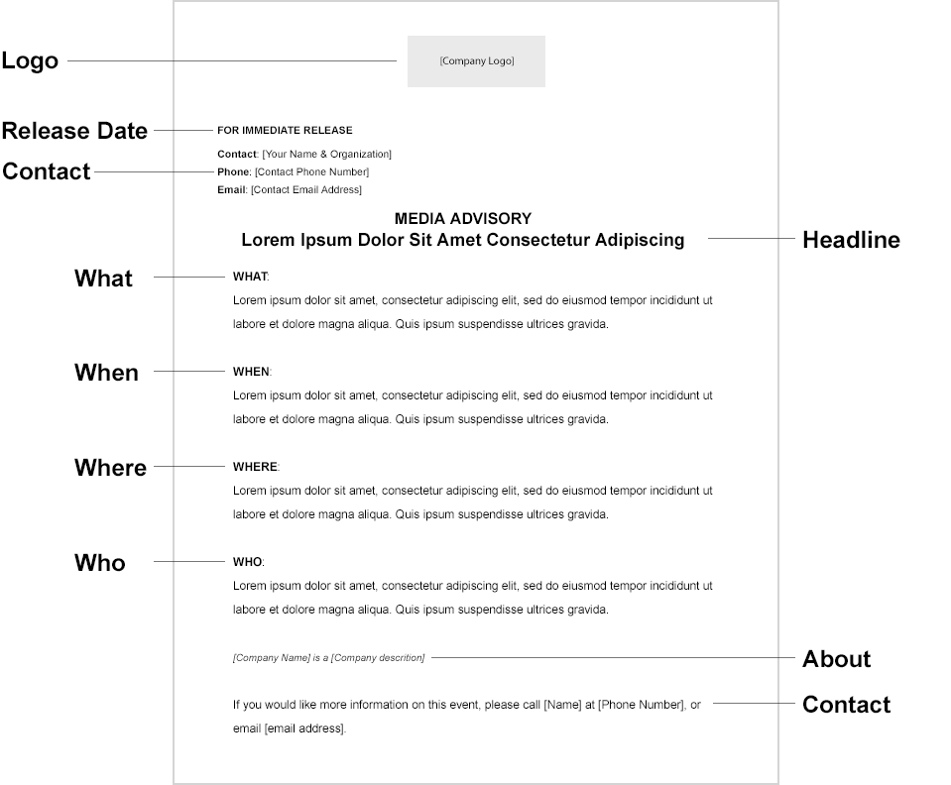
3. Messaging
Messaging
Media Advisory A media advisory is created when you want to get the media to attend and write about your event. To help you out, we’ve created a media advisory template to guide you through each section of writing your media advisory, which includes the headline, body, event details and contact information.
The key difference between a media advisory and a press release is the purpose for sending it. A media advisory is addressed specifically to the media and is a one-page, information-only invitation to get media attendance at an event. A press release should be approached more like an article, which includes quotes and facts, with the goal of generating general interest in the news you are announcing, possibly getting picked up by both small and large media outlets.
7

Slide 8
3. Messaging
Messaging
Typography [Primary Font Name]
[Primary Font Name] is a key element in our brand. It works to maintain consistency, create clarity, and provide equity to the brand.
[Secondary Font Name]
[Secondary Font Name] is used for headlines and sub headlines and [Primary Font Name] is used for body copy.
[Primary Font Name]
Regular
Bold
Black
[Secondary Font Name]
Regular
Bold
Black
8

Slide 9
4. Assets
Assets
Logos
Link to download asset
Link to download asset
Link to download asset
Asset 2
Link to download asset
Link to download asset
Link to download asset
Asset 3
Link to download asset
Link to download asset
Link to download asset
Asset 4
Link to download asset
Link to download asset
Link to download asset
Asset 5
Link to download asset
Link to download asset
Link to download asset
Asset 6
Link to download asset
Link to download asset
Link to download asset
9

Slide 10
Thank You.
Questions? Contact [email address]

